Slide 1
Eat – Sleep –Code - Repeat -
NXP
University Course

Slide 2
Course Contents
General topics, Courses & Labs
General Presentation of the Course
V-Model, Requirements Engineering, Process | Understand and Create Requirements
Architecture (UML) | Virtual Machine Environment Setup
Process | Git, IDE Setup, Compile and Flash the Hello World Project
How Hardware and Software are Linked | From Compiling to Electrical Signals and Debugging
Microcontroller Features (I/O, PWM, ADC, DAC, Timer, Interrupts) | Hands-on Lab (no module – just the dev board)
Node 1: Lights (BCM)
Node 2: Steering
Node 3: Transmission
Node 4: Brakes
Node 5: Door Control + HVAC
Node 6: HMI and CAN Communication

Slide 3
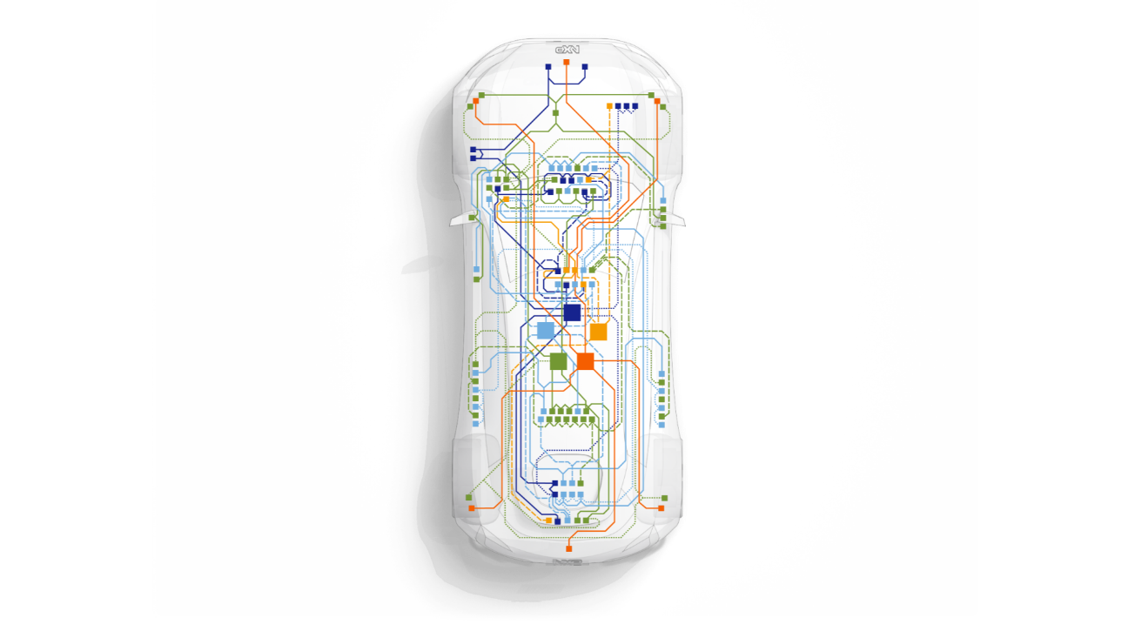






REPLI-CAR NETWORK
Steering control node
Replicate Steering Control Module behavior
· steer base on input controller (steer controller) from HMI
· Communications with other nodes: HMI, PCM, BCM
body control node
Replicate Body Control Module behavior
· Actuate lights (headlamps, turn indicators), horn and washer pump based on input controller from HMI
· Communications with other nodes: HMI, PCM, Brake, Steering, Comfort
steering
bcm
Powertrain control node
Replicate Engine and Transmission Modules behavior
· Accelerate/Decelerate based on input controller from HMI
· Communications with other nodes: HMI, Brake, BCM
hmi node
Replicate Human Machine Interface Module behavior
· handle input/output controllers that actuate different nodes in Repli-Car network. Display information received from the nodes
· Communications with other nodes: Steering, Comfort, PCM, BCM
pcm
HMI
brake control node
Replicate Brake Control Module behavior
· brake actuation and brake lamp indication based on input controller from HMI
· Communications with other nodes: HMI, PCM, BCM
comfort control node
Replicate Comfort Module behavior
· actuate window motor and ventilator using input controller commands from HMI
· Communications with other nodes: HMI, BCM
brake
comfort

Slide 4
Lights (BCM)
01

Slide 5
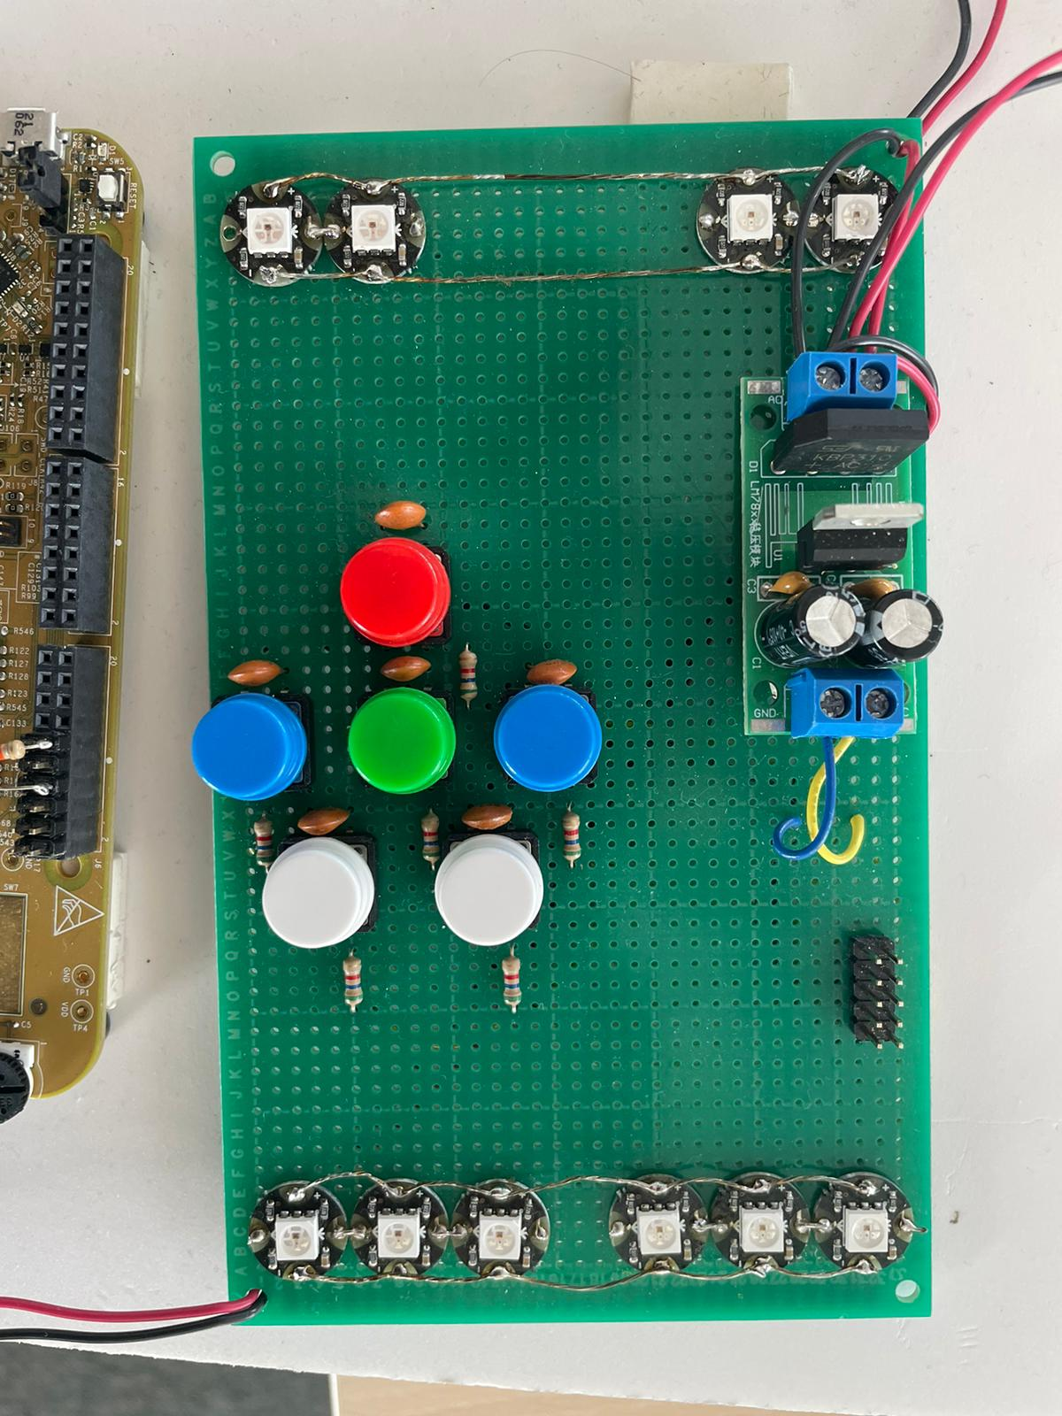
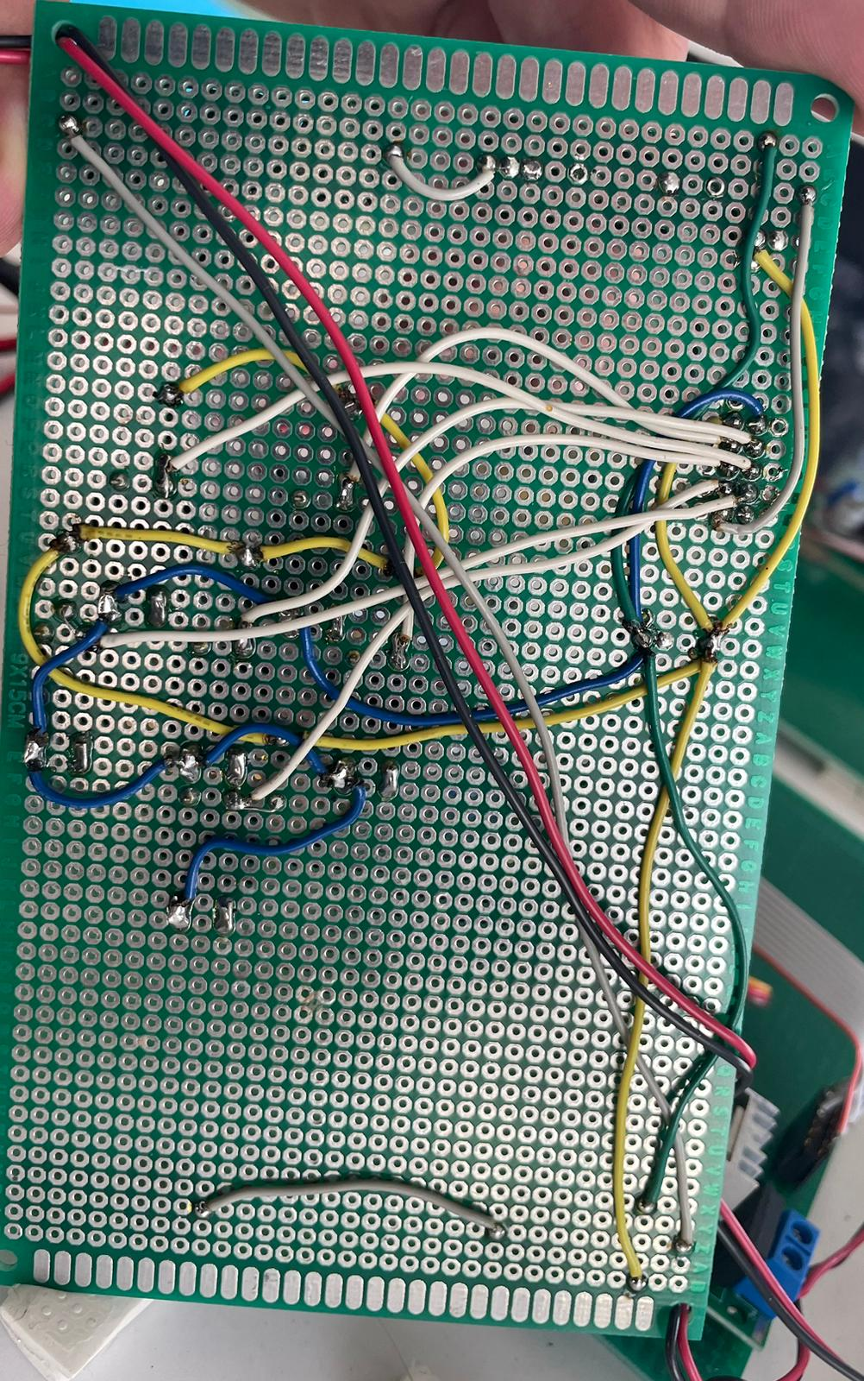
LIGHTS

Slide 6
AC
VCC
AC
GND
5.6k
5.6k
5.6k
5.6k
5.6k
5.6k
Firul verde trece prin legatura
Condensator-Buton
Firul galben trece prin rezistente

Slide 7
NC
PTE1
PTE14
PTE16
GND
K144 PINS
PTD6
PTD7
PTE13
PTE15
NC

Slide 8
Steering
02

Slide 9
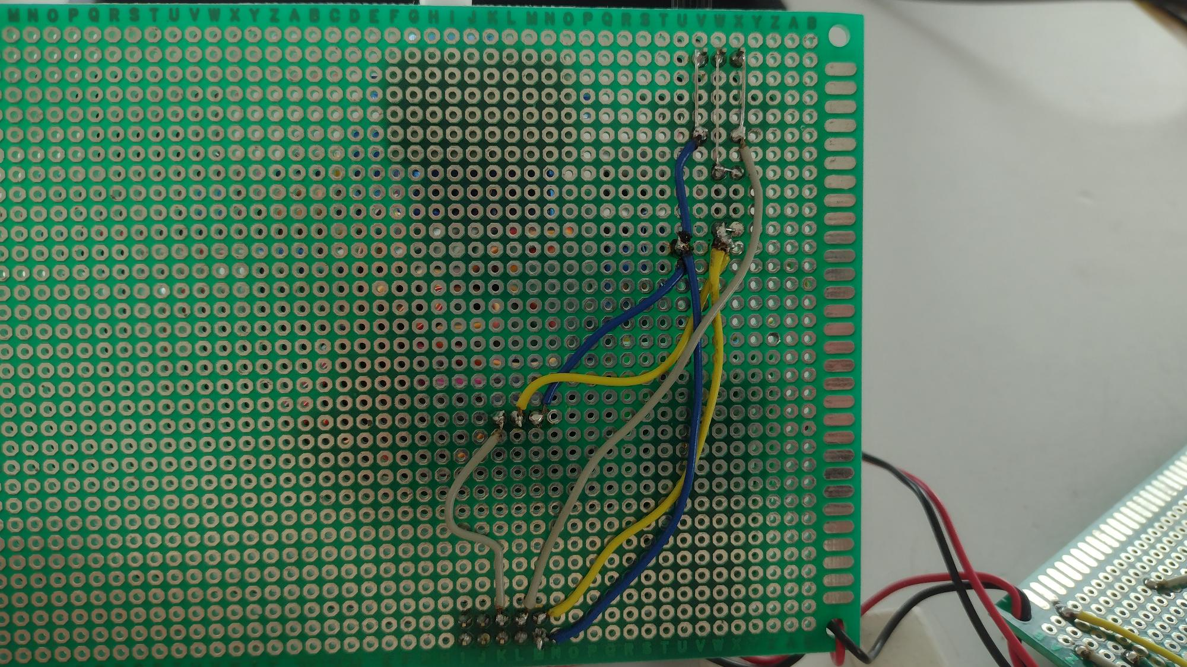
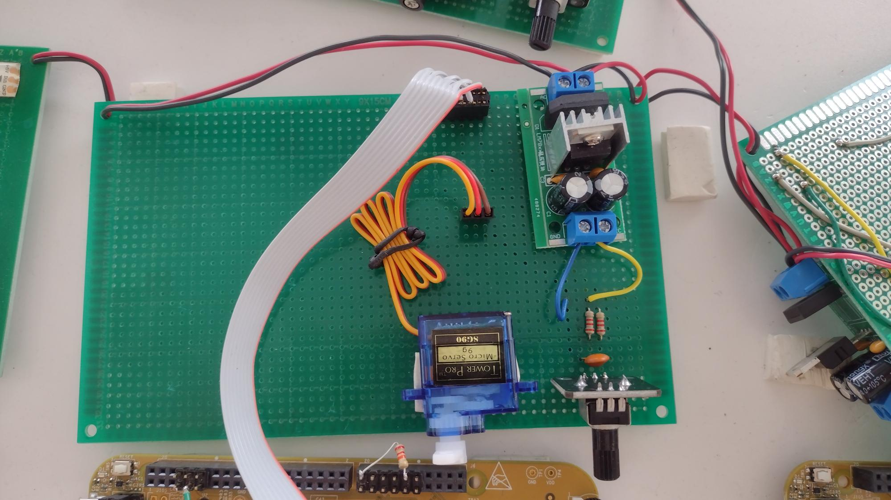
SERVO

Slide 10
Input from the source
GND
12V
PINS
K144 PINS
PINS
PINS
NC
NC
NC
NC
GND
VOLTAGE REGULATOR
NC
NC
PTE 16
PTA 15
NC
GND
Vcc
5V
1.1K
Matching arrow colors means a wire connection
SERVO
GND
Vcc
POT
C
OUT

Slide 11
Transmission
03

Slide 12
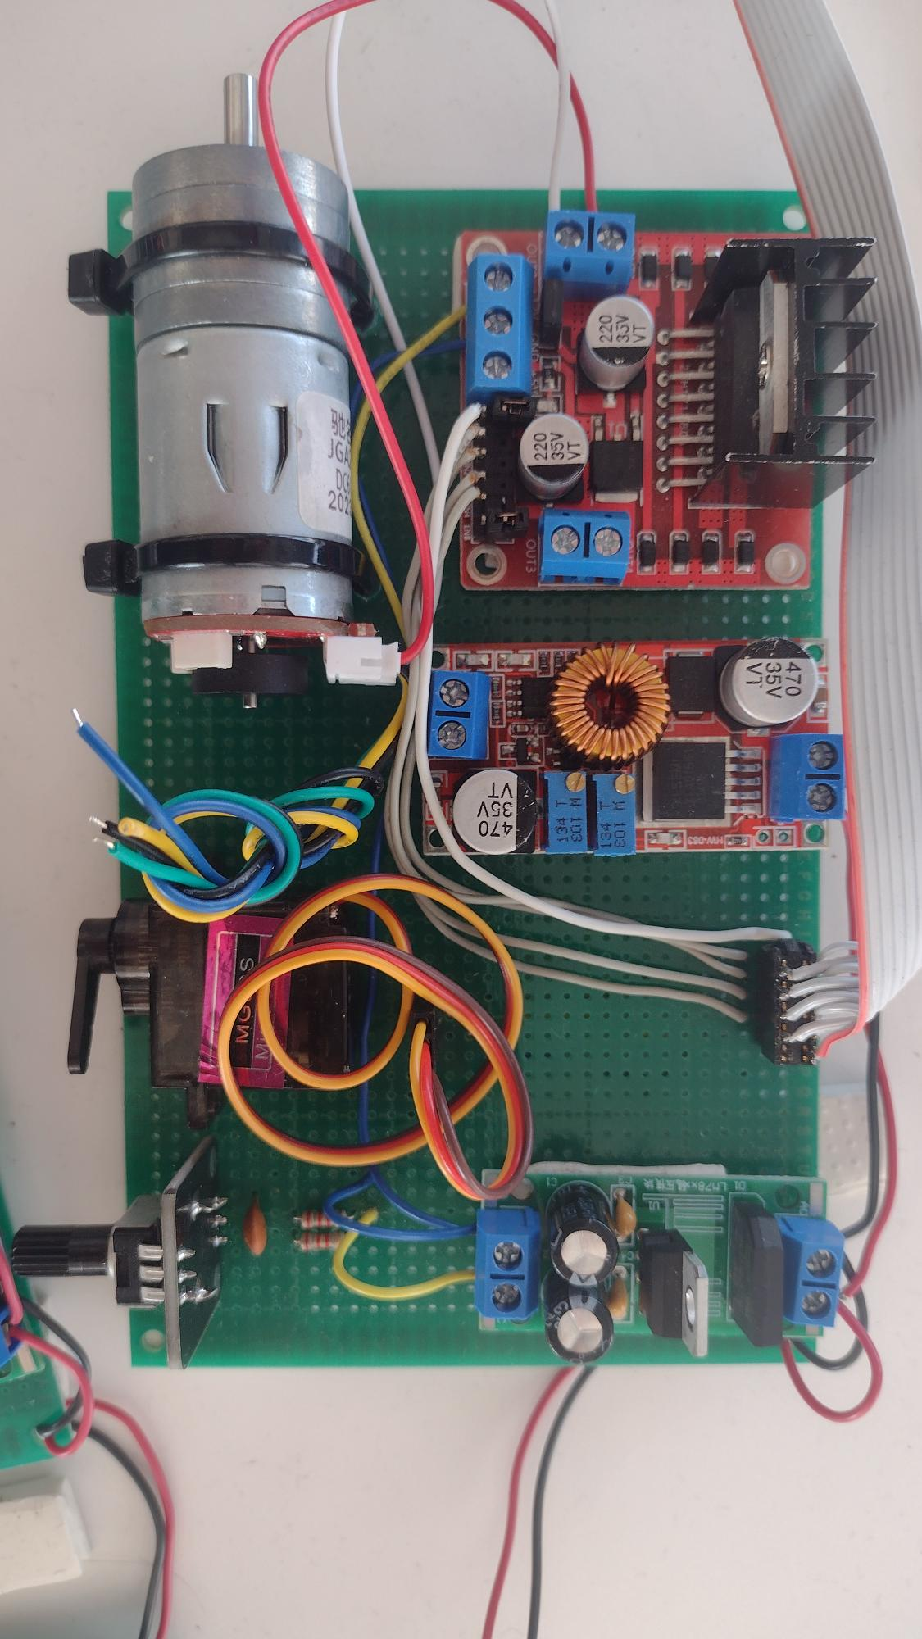
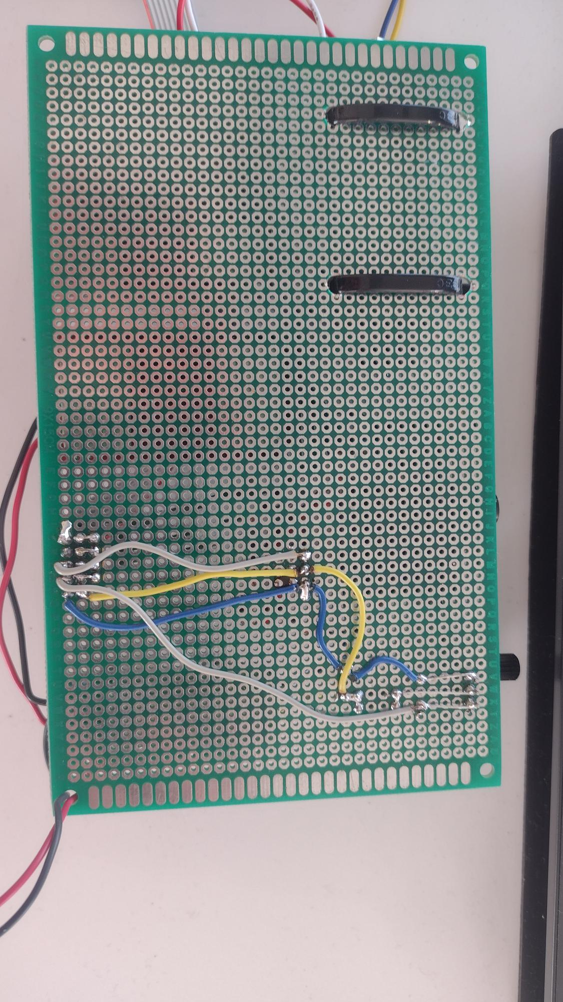
MOTOR

Slide 13
GND
12V
Input from the source
GND
12V
PINS
HW-083
PINS
L298N
MOTOR DRIVER
VOLTAGE REGULATOR
GND
Vcc
5V
1.1K
MOTOR
SERVO
GND
Vcc
POT
C
OUT

Slide 14
PINS
K144 PINS
PTE14
NC
PTE16
PTD11
GND
PTE1
PTE15
NC
NC
NC

Slide 15
Brake
04

Slide 16
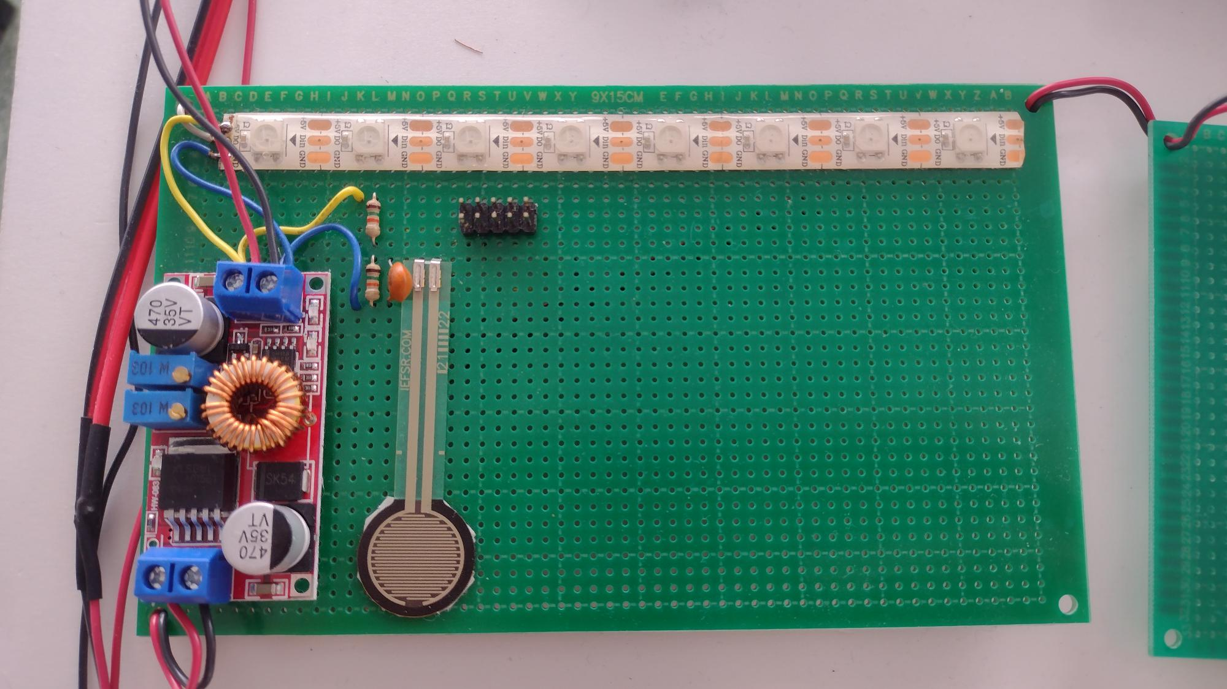
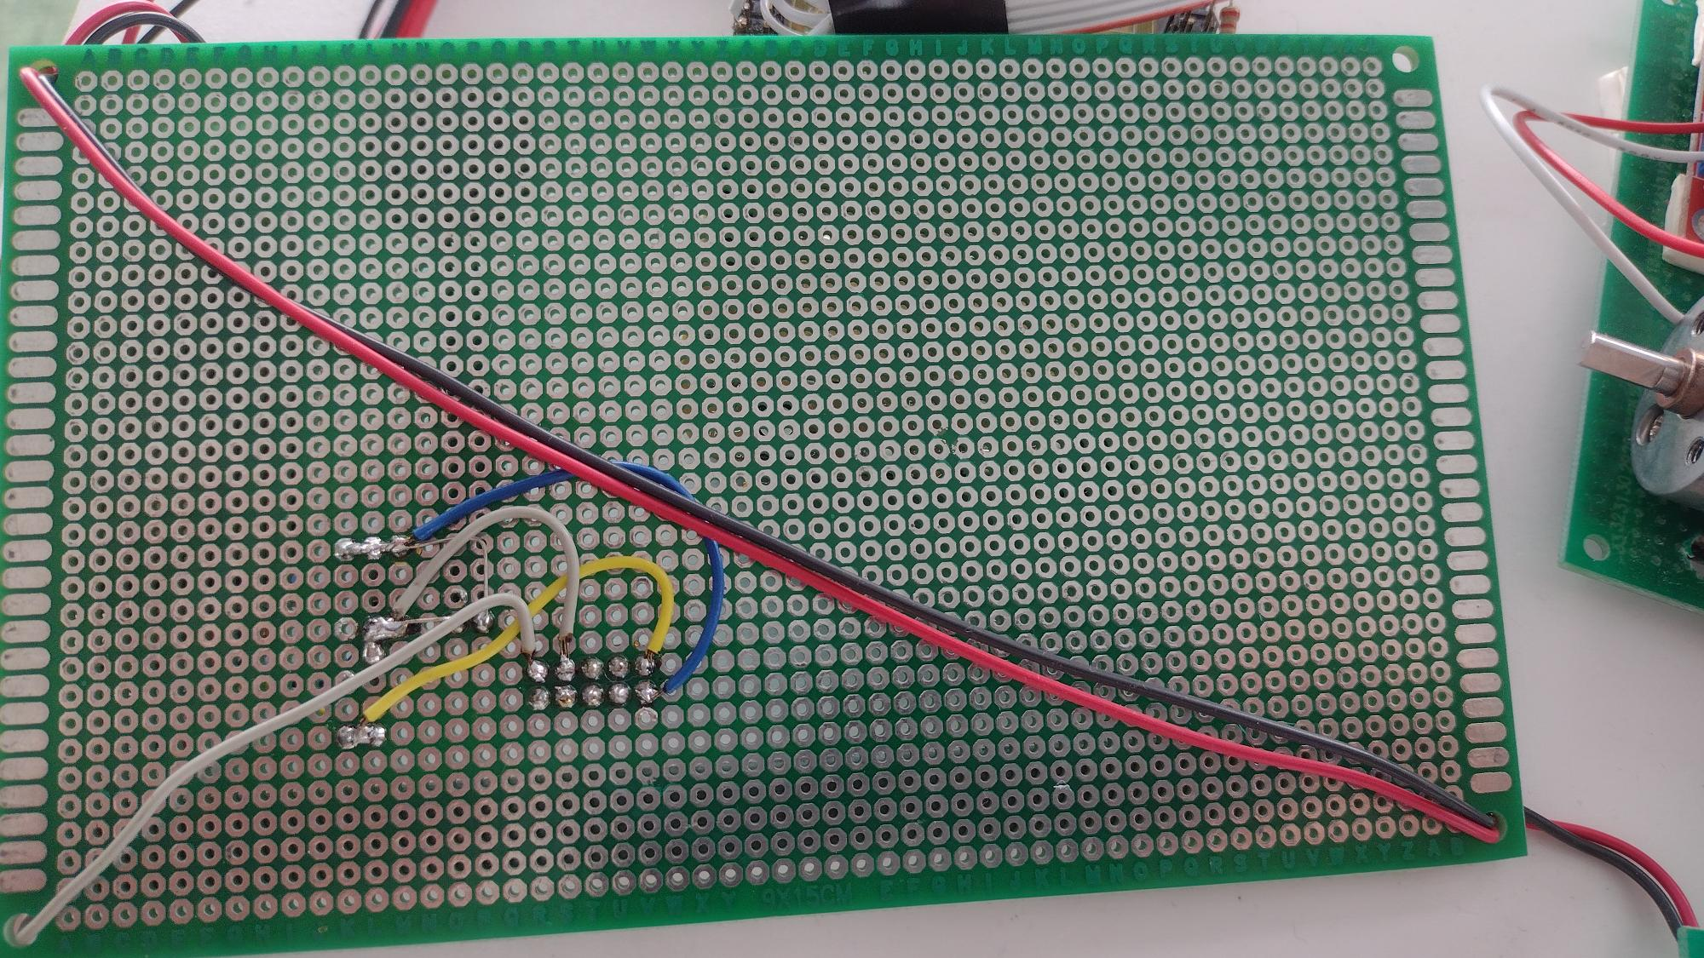
BRAKE

Slide 17
BAND WITH 8 LEDS
PTE 16
PINS
PINS
15K
15K
C
HW-083
PRESSURE SENSOR
12V
GND

Slide 18
Door Control + HVAC
05

Slide 19
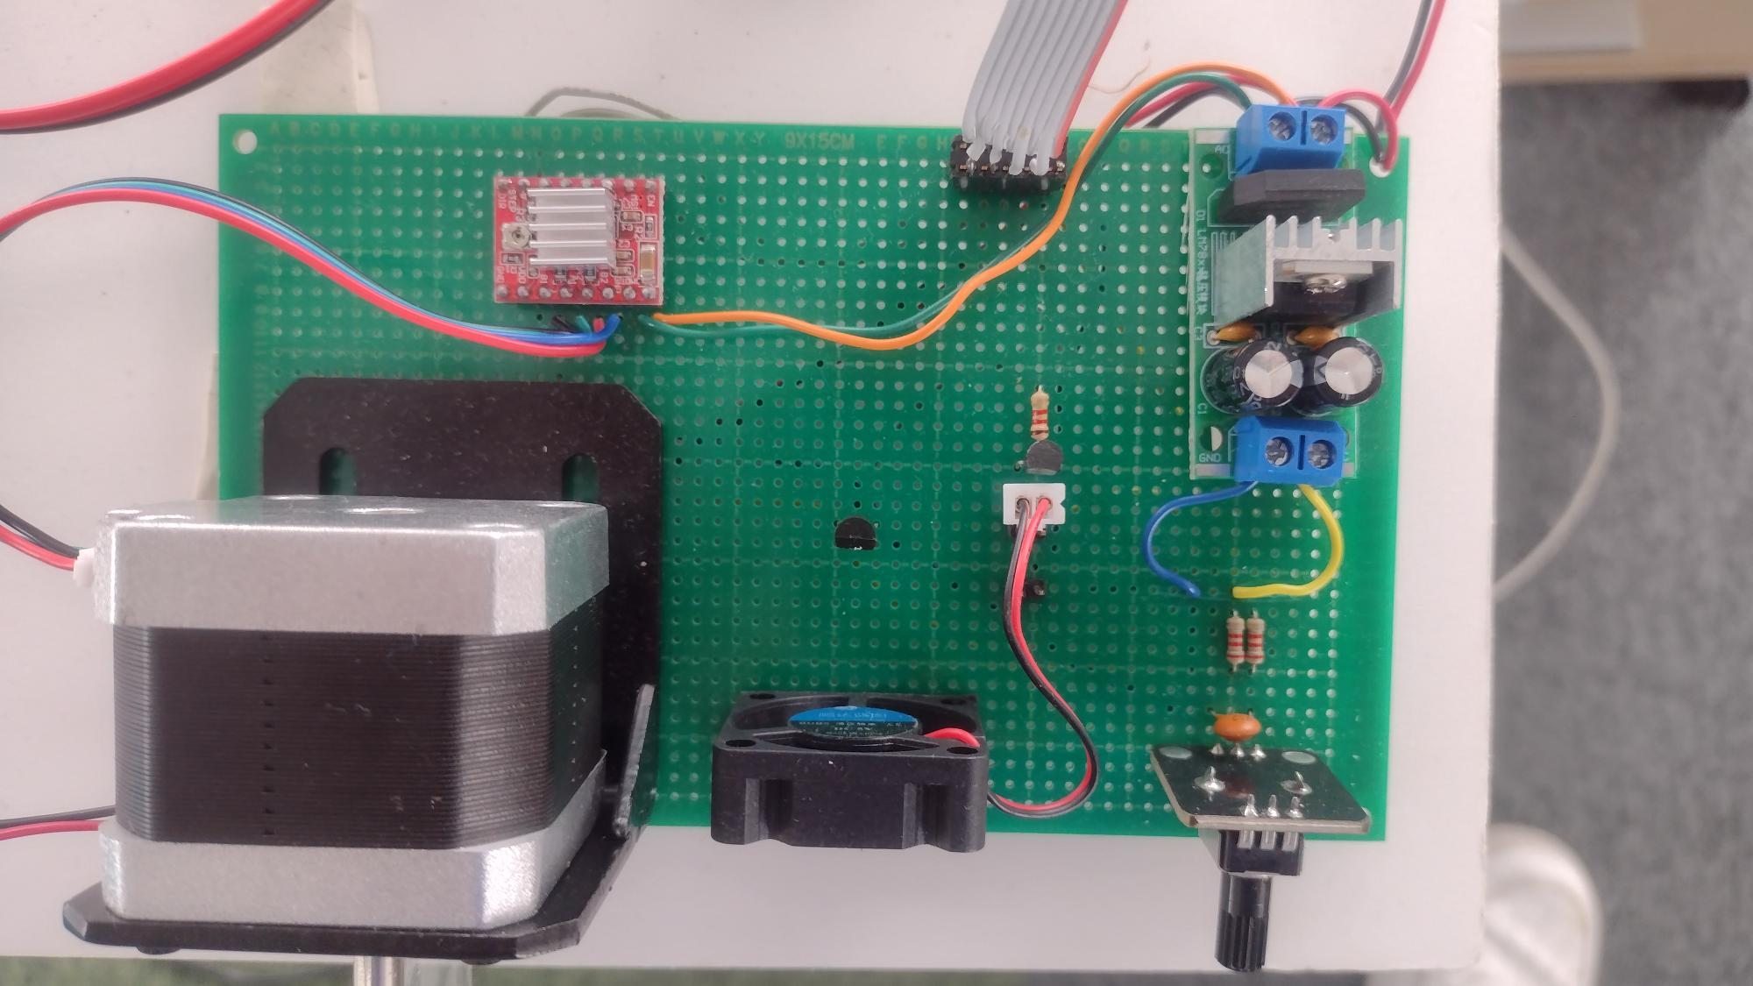
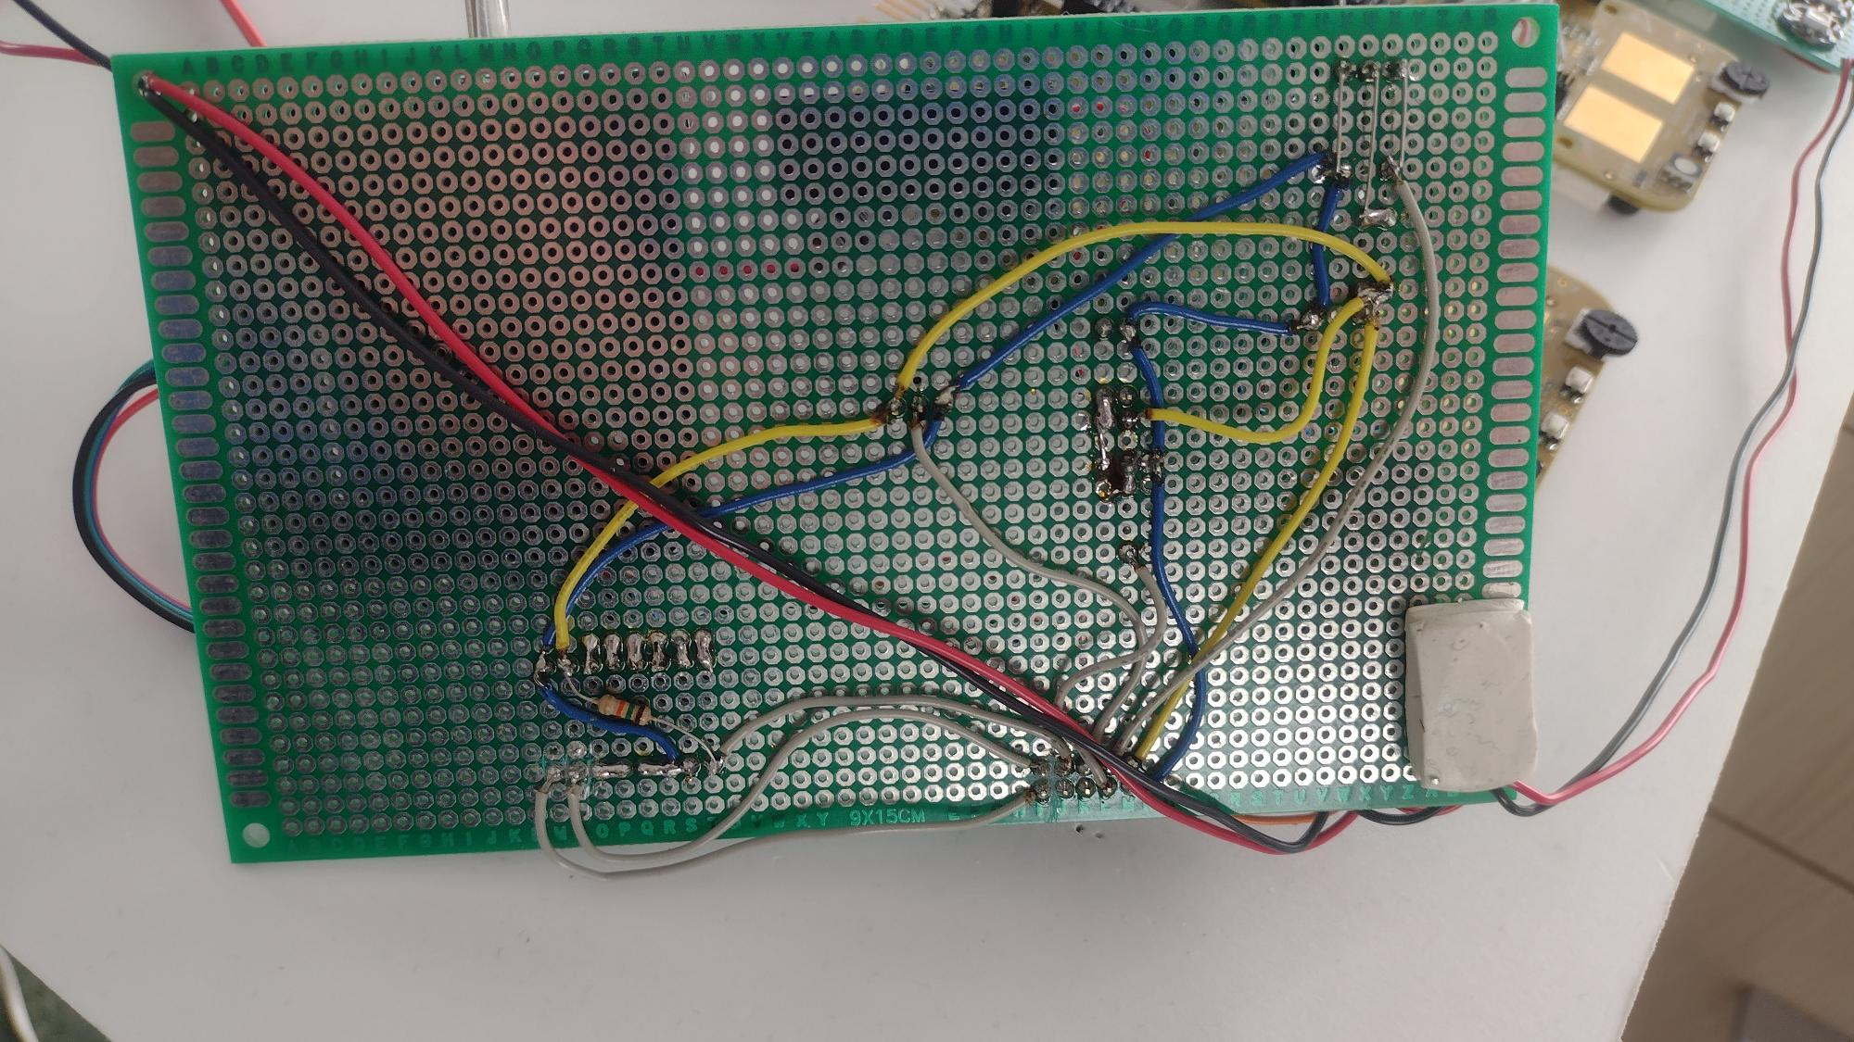
STEPPER AND TEMP FAN

Slide 20
These pins are connected
Input from the source
12V
PINS
Step Driver
15K
VOLTAGE REGULATOR
1.2K
C546B Transistor
Matching arrow colors means a wire connection
G
Vcc
5V
Temperature sensor
G
Vcc
1.1K
STEPPER
C
FAN
POT

Slide 21
K144 PINS
PTE16
NC
NC
PTD7
G
PTE1
PTE15
PTD10
PTD11
NC

